Slide 1
ITA5002
Data Structures and Algorithm
Module3 - Trees
Dr. S. Bharathiraja
Associate Professor
School of Computing Science and Engineering
VIT – Chennai

Slide 2
Trees: Outline
Introduction
  Representation Of Trees
Binary Trees / Types of Binary Trees
Binary Tree Traversals
Binary Search Trees
Expression Tree
AVL Tree

Slide 3
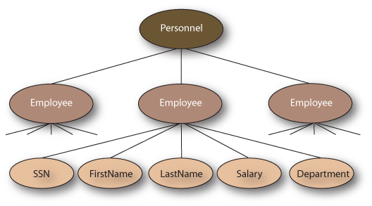
Introduction (1/8)
A tree structure means that the data are organized so that items of information are related by branches (Hierarchical Relationship)
Example:

Slide 4
Introduction (2/8)
Definition (recursively): A tree is a finite set of one or more nodes such that
  There is a specially designated node called root.
  The remaining nodes are partitioned into n>=0 disjoint set T₁,…,T_{n}, where each of these sets is a tree. T₁,…,T_{n} are called the subtrees of the root.
Every node in the tree is the root of some subtree

Slide 5
Introduction (3/8)
Some Terminology
  Node: The item of information.
  Degree: The number of subtrees of a node (No of nodes attached to a given node).
  Degree of a tree: The maximum of the degree among all the nodes in the tree.
  Terminal nodes (or leaf): Nodes that have degree zero
  Non-terminal nodes: Nodes that have minimum one child or that don’t belong to terminal nodes.(Degree >=1).
  Children: The node which is immediately attached to a given node.
  Parent: X is the parent of its children.

Slide 6
Introduction (4/8)
Some Terminology (cont’d)
  siblings: children of the same parent are said to be siblings.
  Ancestors of a node: All the nodes along the path from the root to that node.
  The level of a node: defined by letting the root be at level one. If a node is at level l, then its children’s are at level l+1.
  Height (or depth): The maximum level of any node in the tree

Slide 7
Introduction (5/8)
Example
  A is the root node
  B is the parent of D and E
  C is the sibling of B
  D and E are the children of B
  D, E, F, G, I are external nodes, or leaves
  A, B, C, H are internal nodes
  The level of E is 3
  The height (depth) of the tree is 4
  The degree of node B is 2
  The degree of the tree is 3
  The ancestors of node I is A, C, H
  The descendants of node C is F, G, H, I
Property: (# edges) = (#nodes) - 1
Level
A
1
B
C
2
H
3
D
E
F
G
I
4

Slide 8
Binary Trees
Binary trees are characterized by the fact that any node can have at most two branches
Definition (recursive):
  A binary tree is a finite set of nodes that is either empty or consists of a root and two disjoint binary trees called the left subtree and the right subtree
Thus the left subtree and the right subtree are distinguished
Any tree can be transformed into binary tree
  by left child-right sibling representation
A
A
B
B

Slide 9
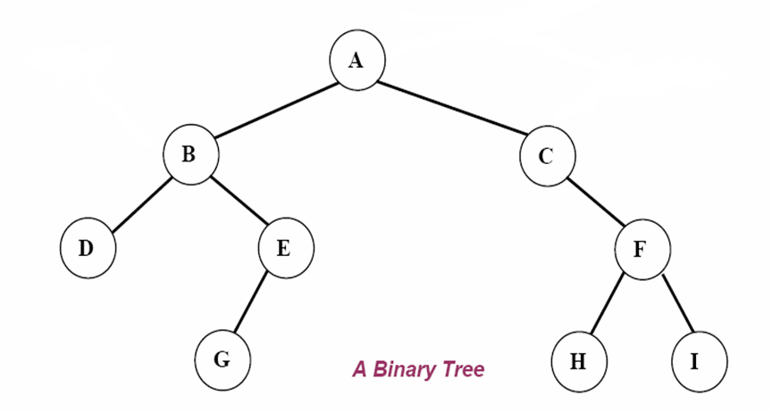
BINARY TREES: BASIC DEFINITIONS
root
left subtree
right subtree

Slide 10
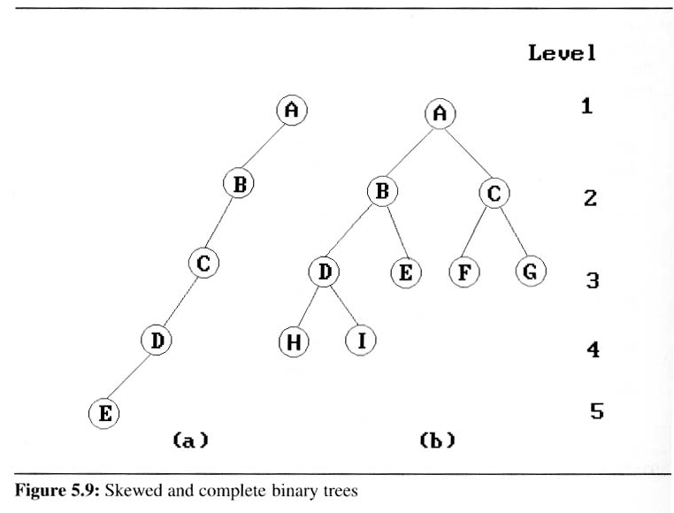
Binary Trees (3/9)
Two special kinds of binary trees:
(a) skewed tree, (b) complete binary tree

Slide 11
Binary Trees (4/9)
Properties of binary trees
  Lemma 5.1 [Maximum number of nodes]:
  The maximum number of nodes on level i of a binary tree is 2^{i-1}, i ≥1.
  The maximum number of nodes in a binary tree of depth k is 2^{k}-1, k≥1.
  Lemma 5.2 [Relation between number of leaf nodes and degree-2 nodes]:
  For any nonempty binary tree, T, if n_{l} is the number of leaf nodes and n_{d} is the number of nodes of degree 2, then n_{l} = n_{d} + 1.
These lemmas allow us to define full and complete binary trees

Slide 12
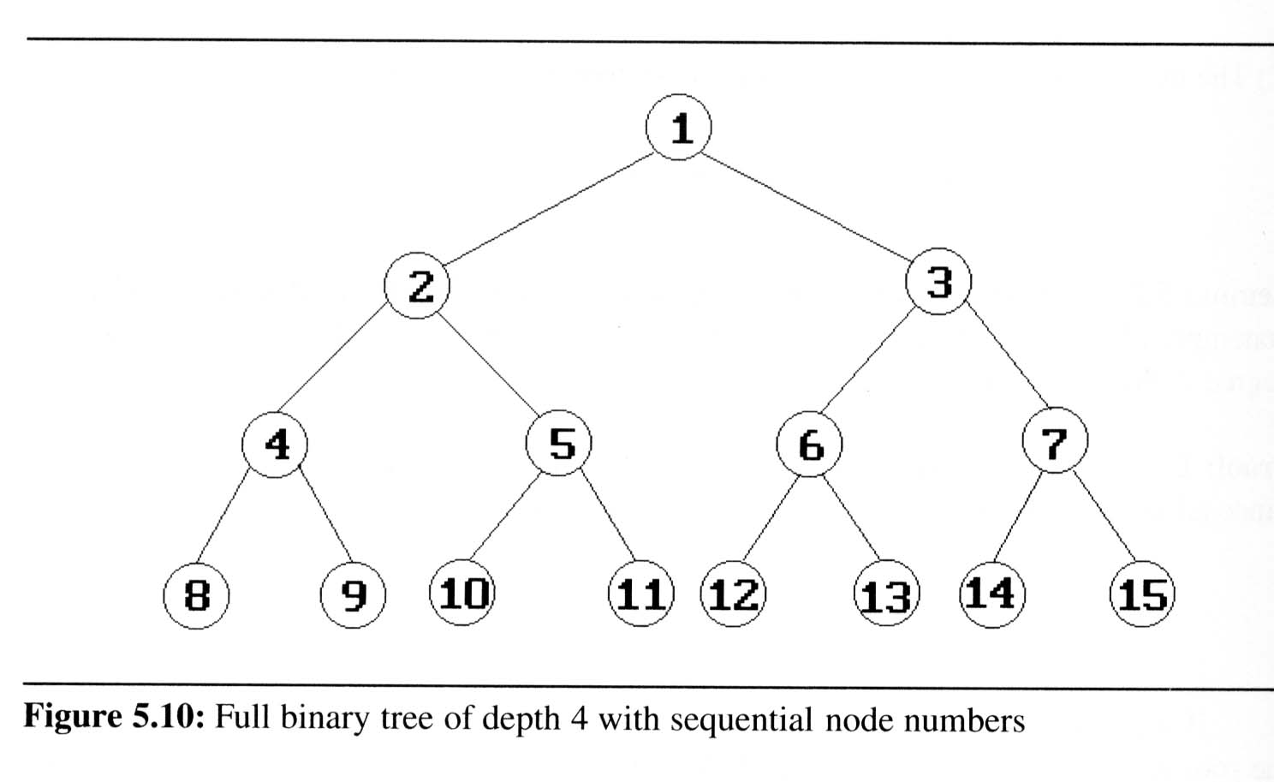
Lemma 5.1 [Maximum number of nodes]:
  The maximum number of nodes on level i of a binary tree is 2^{i-1}, i ≥1.
    if i=3 then substituting in the formula
    2³⁻¹ = 4
  The maximum number of nodes in a binary tree of depth k is 2^{k}-1, k≥1.
    If k=3 then substituting in the formula
    2^{k}-1 = 2³-1= 8-1 = 7
    2^{k}-1 = 2⁴-1= 16-1 = 15

Slide 13
Lemma 5.2 [Relation between number of leaf nodes and degree-2 nodes]:
  For any nonempty binary tree, T, if n_{l} is the number of leaf nodes and n_{d} is the number of nodes of degree 2, then
  n_{l} = n_{d} + 1.
  N_{d} = 7
  n_{l} = n_{d} + 1 = 7+1= 8
  n_{l} = 8.
  n_{d} = n_{l} - 1 = 8-1 = 7

Slide 14
Binary Trees (5/9)
Definition:
  A full binary tree of depth k is a binary tree of depth k having 2^{k}-1 nodes, k ≥ 0.
  A binary tree with n nodes and depth k is complete if its nodes correspond to the nodes numbered from 1 to n in the full binary tree of depth k.
  From Lemma 5.1, the
  height of a complete
  binary tree with n nodes
  is ⎡log₂(n+1)⎤

Slide 15
Binary tree representations (using array)
  Lemma 5.3: If a complete binary tree with n nodes is represented sequentially, then for any node with index i, 1 ≤ i ≤ n, we have
  Allocate memory space of 2^{k+1}-1 spaces
  parent(i) is at ⎣i /2⎦ if i ≠ 1.
  If i = 1, i is at the root and has no parent.
  LeftChild(i) is at 2i if 2i ≤ n.
  If 2i > n, then i has no left child.
  RightChild(i) is at 2i+1 if 2i+1 ≤ n.
  If 2i +1 > n, then i has no left child
A
1
[1]
[2]
[3]
[4]
[5]
[6]
[7]
B
2
C
3
A B C — D — E
Level 1
D
E
Level 2
Level 3
4
5
6
7

Slide 16
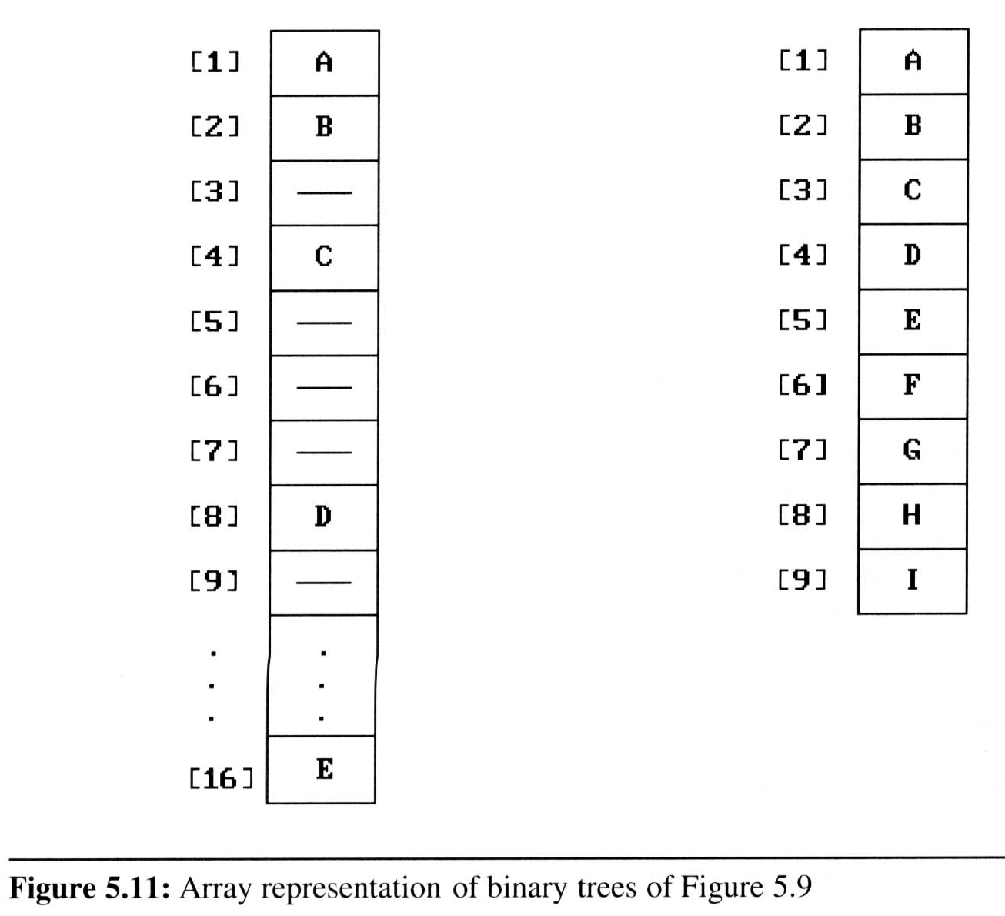
Binary Trees (7/9)
Binary tree representations (using array)
  Waste spaces: in the worst case, a skewed tree of depth k requires 2^{k}-1 spaces. Of these, only k spaces will be occupied
  Insertion or deletion
  of nodes from the
  middle of a tree
  requires the
  movement of
  potentially many nodes
  to reflect the change in
  the level of these nodes

Slide 17
Binary tree representations (using array)

Slide 18
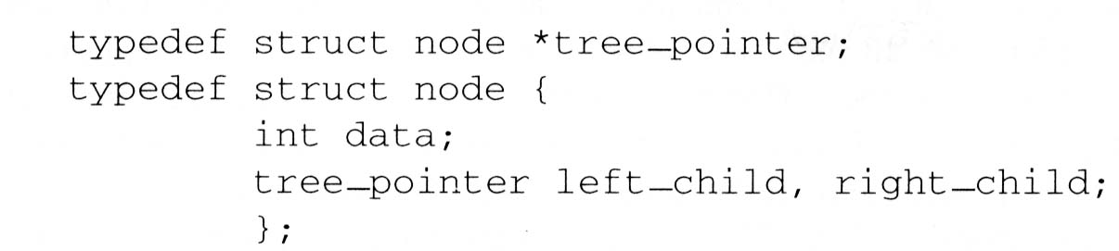
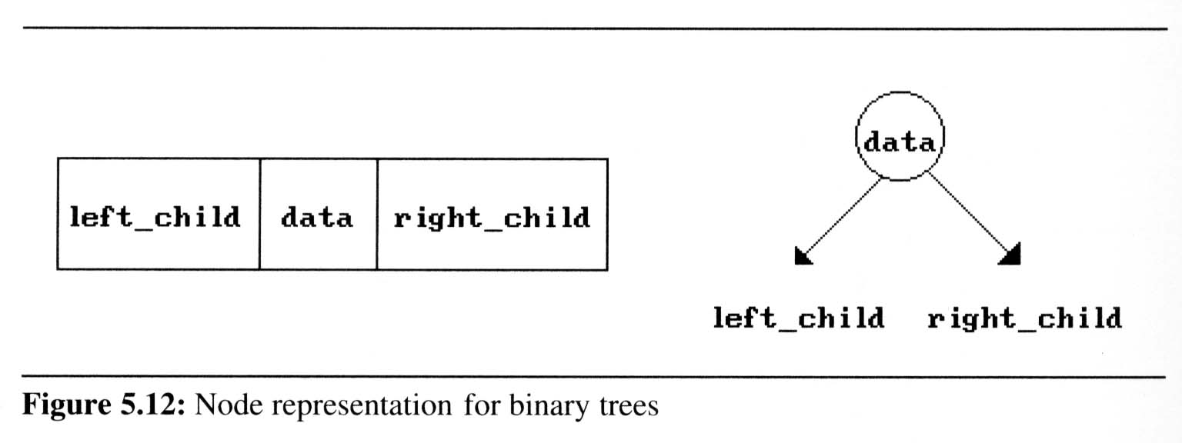
Binary Trees (8/9)
Binary tree representations (using link)

Slide 19
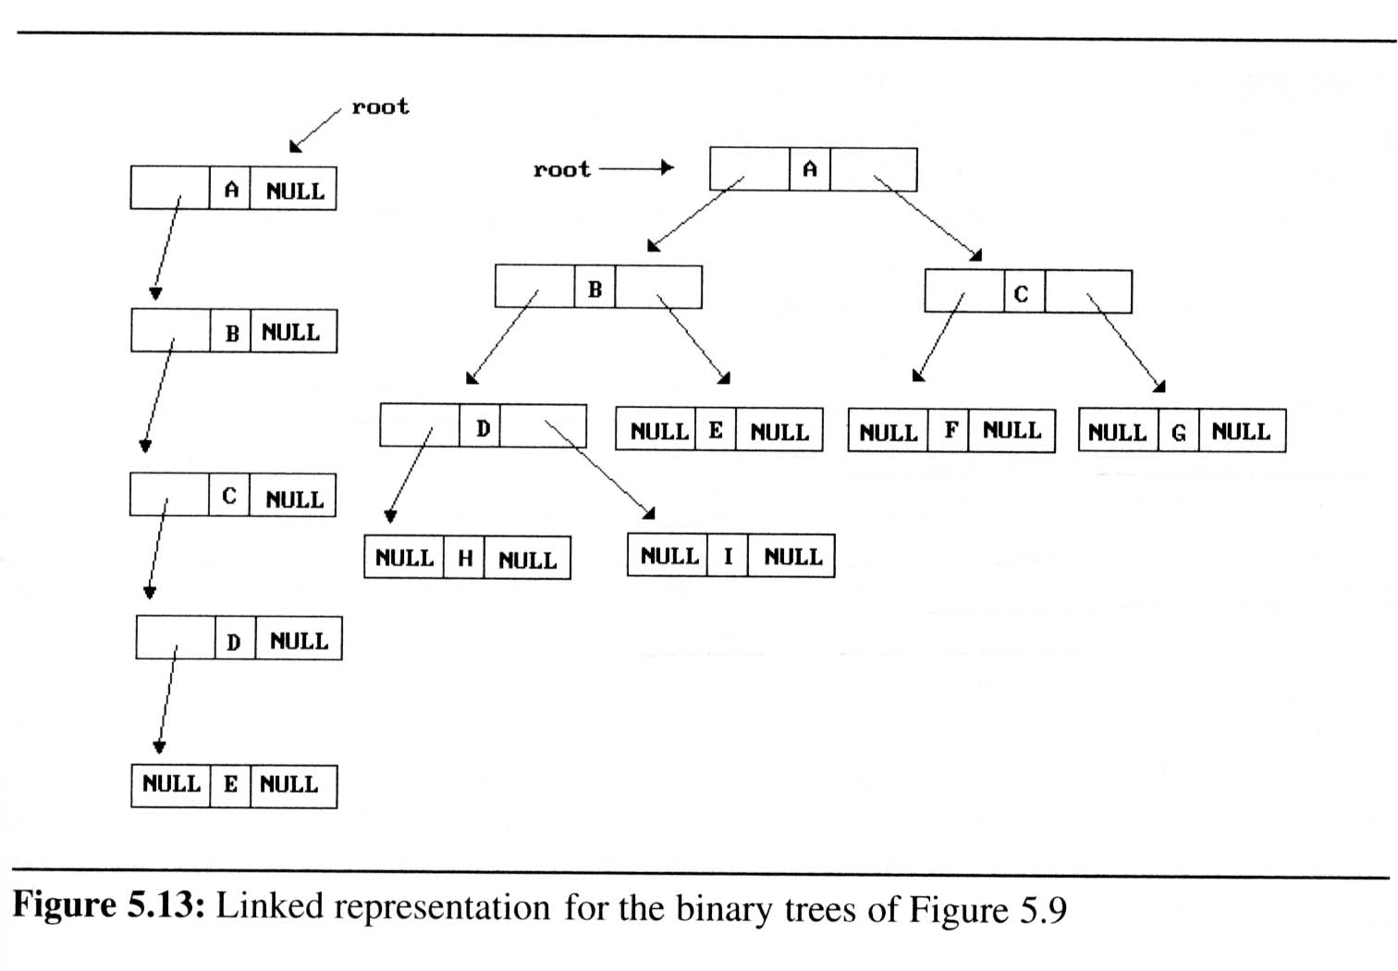
Binary Trees (9/9)
Binary tree representations (using link)

Slide 20
Binary tree representations (using link)
63
41
89
34
72
95
2000 63 3000
1000
4000 41 Null
5000 89 6000
2000
3000
Null 34 Null
Null 72 Null
Null 95 Null
4000
5000
6000

Slide 21
Binary Tree Traversals
Types of Tree Traversals:
Pre - order traversal (Root → Left → Right)
Post - order traversal (Left → Right → Root)
In – order traversal (Left → Root → Right )
Level – order traversal (Level by level and in each level traverse from left to right)

Slide 22
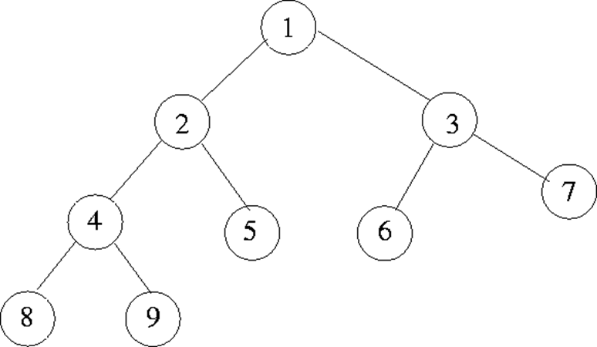
Binary Tree Traversals
1.In - order traversal (Left → Root → Right) [ symmetry traversal ]
8 → 4 → 9 → 2 → 5 → 1 → 6 → 3 → 7

Slide 23
Binary Tree Traversals
2. post - order traversal (Left → Right → Root)
8 → 9 → 4 → 5 → 2 → 6 → 7 → 3 → 1 (End order Traversal)

Slide 24
Binary Tree Traversals
3.Pre - order traversal (Root → Left → Right ) [ Depth order traversal ]
1 → 2 → 4 → 8 → 9 → 5 → 3 → 6 → 7

Slide 25
Binary Tree Traversals
4.Level-order traversal (Level1→Level2→…)
In each Levels (Left→Right)
1 → 2 → 3 → 4 → 5 → 6 → 7 → 8 → 9

Slide 26
63
41
89
72
95
34
56

Slide 27
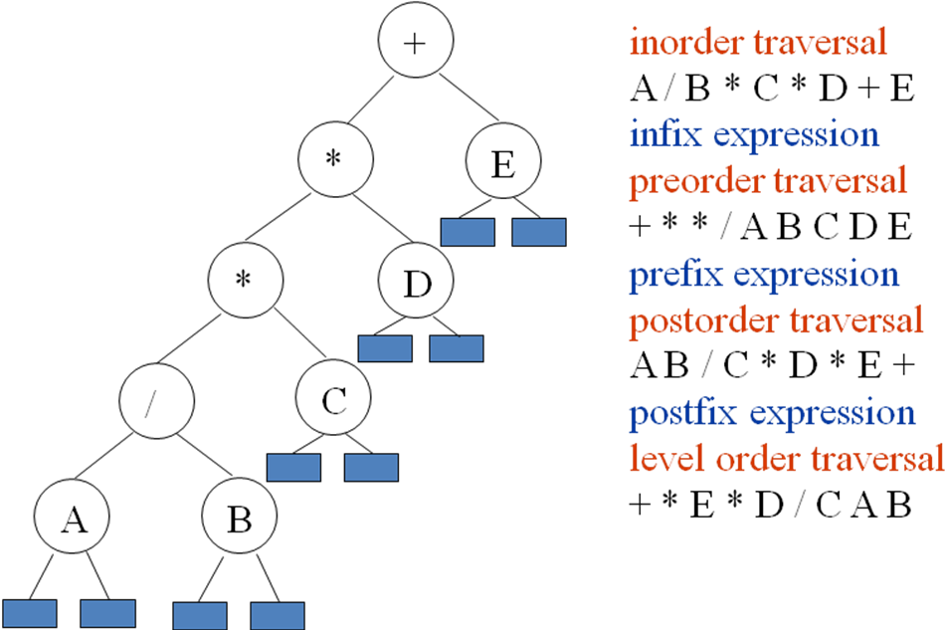
Expression Tree

Slide 28
Binary Tree Traversals (1/9)
How to traverse a tree or visit each node in the tree exactly once?
  There are six possible combinations of traversal
LVR, LRV, VLR, VRL, RVL, RLV
  Adopt convention that we traverse left before
  right, only 3 traversals remain
LVR (inorder), LRV (postorder), VLR (preorder)
left_child
data
right_child
V
:
visiting
node
L: moving left
R: moving right

Slide 29
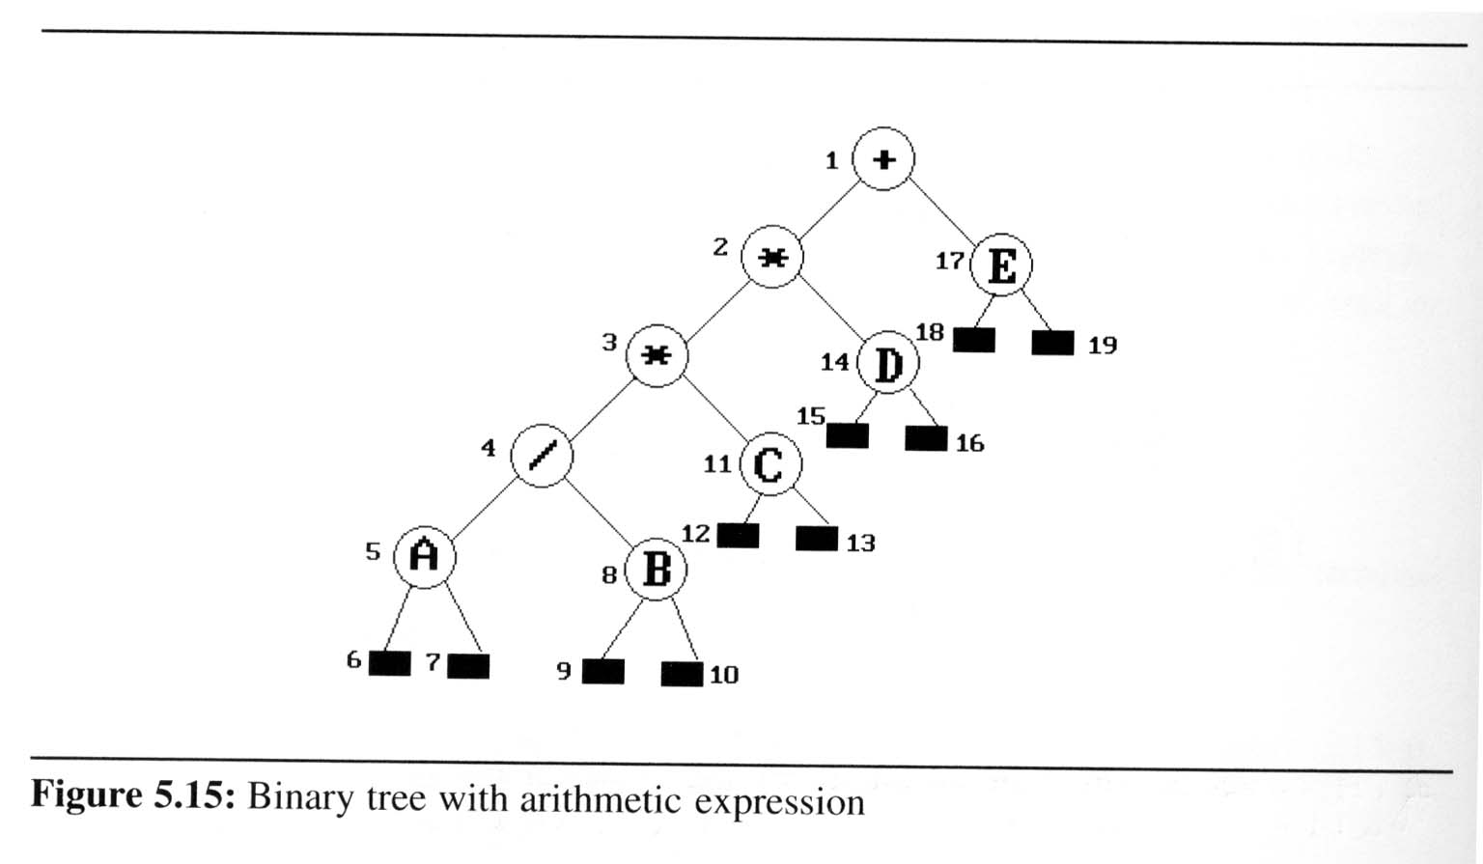
Binary Tree Traversals (2/9)
Arithmetic Expression using binary tree
  inorder traversal (infix expression)
  A / B * C * D + E
  preorder traversal (prefix expression)
  + * * / A B C D E
  postorder traversal
  (postfix expression)
  A B / C * D * E +
  level order traversal
  + * E * D / C A B

Slide 30
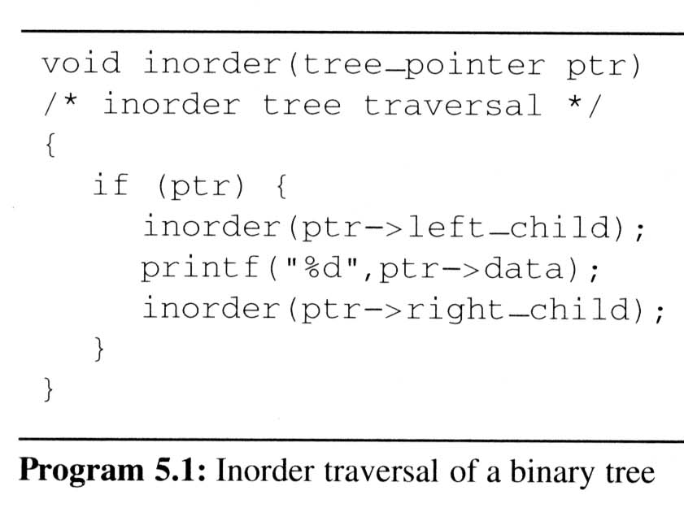
Binary Tree Traversals (3/9)
Inorder traversal (LVR) (recursive version)
output:
A
/
B
*
C
*
D
+
E
ptr
L
V
R

Slide 31
Void inorder(ptr)
{ if(ptr) // Address of root node
{ inorder(ptr->left_child);
printf(“%d”,ptr->data);
inorder(ptr->right_child) }
2) Void inorder(ptr//address of *)
{ if(ptr)
{ inorder(ptr->left_child);
printf(“%d”,ptr->data);
inorder(ptr->right_child) }
3)Void inorder(ptr//address of *3)
{ if(ptr) // Address of root node
{ inorder(ptr->left_child);
printf(“%d”,ptr->data);
inorder(ptr->right_child) }
4)Void inorder(ptr//address of /)
{ if(ptr) // Address of root node
{ inorder(ptr->left_child);
printf(“%d”,ptr->data);
inorder(ptr->right_child) }
5)Void inorder(ptr//address of A)
{ if(ptr) // Address of root node
{ inorder(ptr->left_child);
printf(“%d”,ptr->data);
inorder(ptr->right_child) }
6)Void inorder(ptr //NULL)
{ if(ptr) // Address of root node
{ }
7)Void inorder(ptr //NULL)
{ if(ptr) // Address of root node
{ }

Slide 32
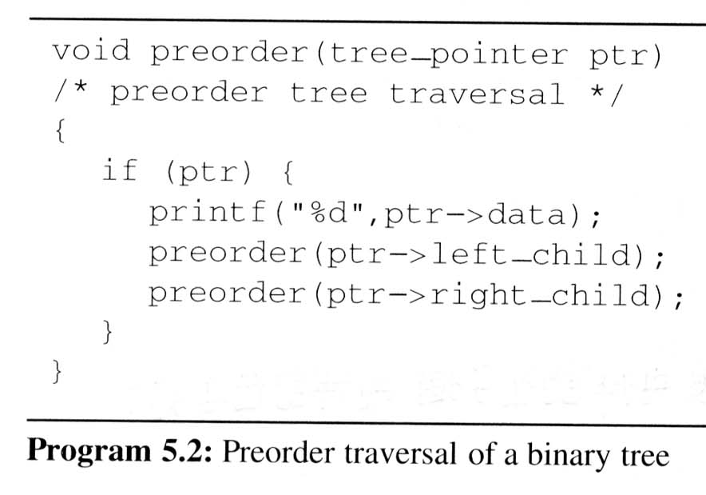
Binary Tree Traversals (4/9)
Preorder traversal (VLR) (recursive version)
output:
+
*
*
/
A
B
C
D
E
V
L
R

Slide 33
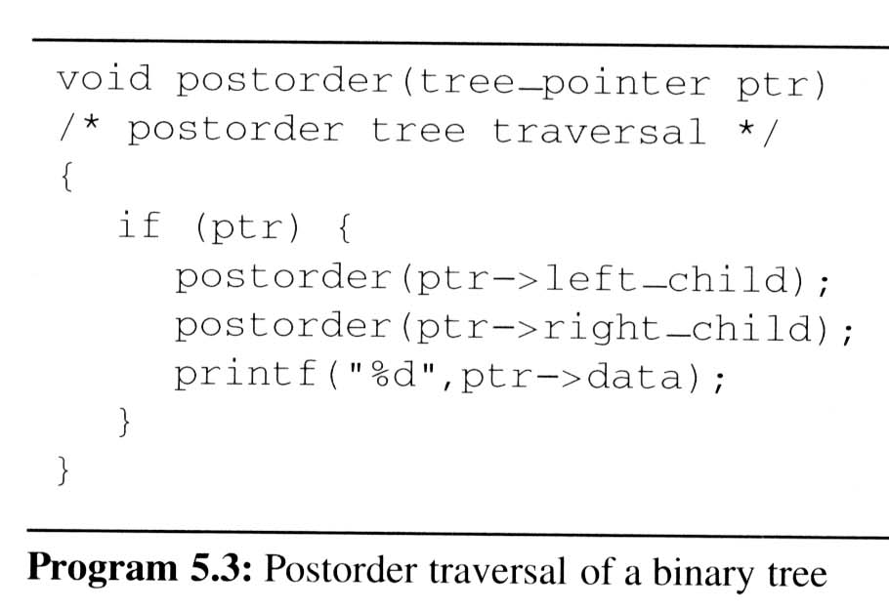
Binary Tree Traversals (5/9)
Postorder traversal (LRV) (recursive version)
output:
A
B
/
C
*
D
*
E
+
L
R
V

Slide 34
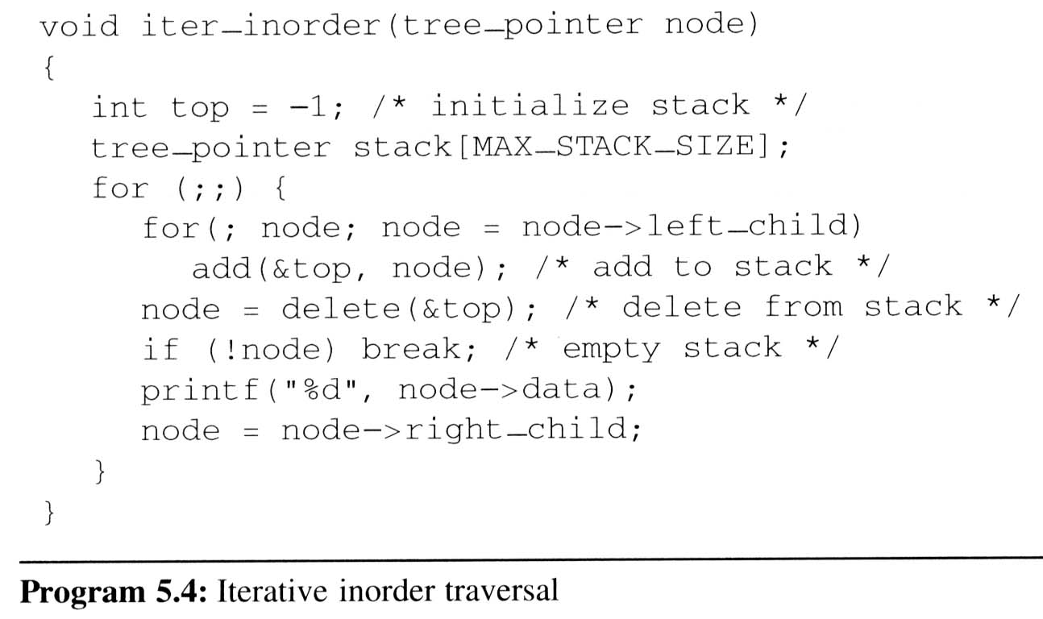
Binary Tree Traversals (6/9)
Iterative inorder traversal
  we use a stack to simulate recursion
5
4
8
11
3
14
2
17
1
A
/
B
*
C
D
*
E
+
L
V
R
output:
A
/
B
*
C
*
D
+
E
node

Slide 35
Binary Tree Traversals (7/9)
Analysis of inorder2 (Non-recursive Inorder traversal)
  Let n be the number of nodes in the tree
  Time complexity: O(n)
    Every node of the tree is placed on and removed
    from the stack exactly once
  Space complexity: O(n)
    equal to the depth of the tree which
    (skewed tree is the worst case)

Slide 36
Binary Tree Traversals (8/9)
Level-order traversal
  method:
    We visit the root first, then the root’s left child, followed by the root’s right child.
    We continue in this manner, visiting the nodes at each new level from the leftmost node to the rightmost nodes
  This traversal requires a queue to implement

Slide 37
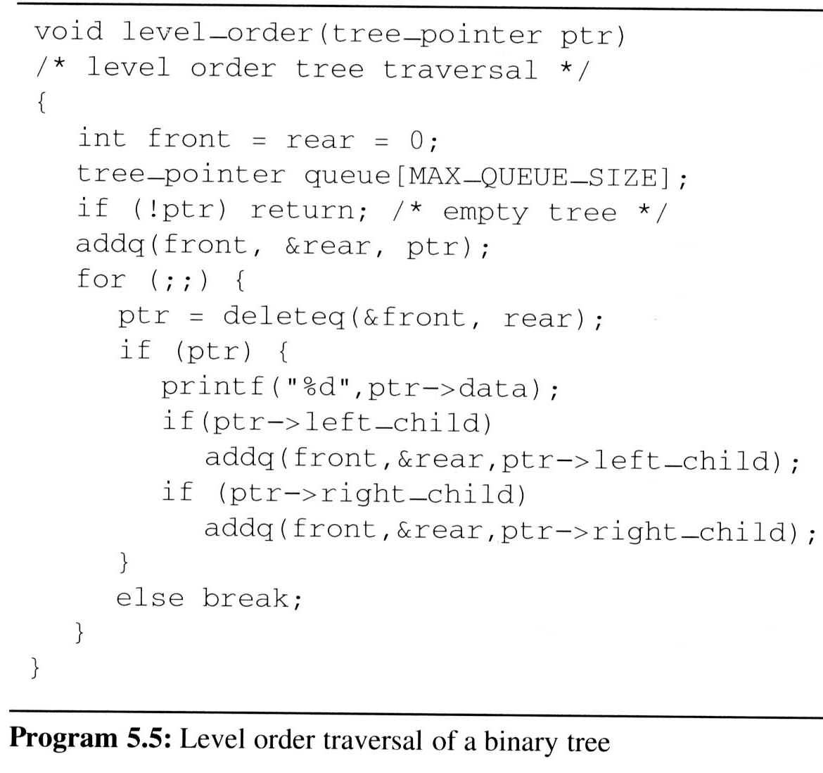
Binary Tree Traversals (9/9)
Level-order traversal (using queue)
output:
+
*
E
*
D
/
C
A
B
1
2
17
3
14
4
11
5
8
+
*
E
*
D
/
C
A
B
FIFO
ptr

Slide 38
Convert the following General Tree to Binary tree
1.Root node of the General tree will be the Root node of Binary tree.
2.LST of the root node in a General tree will be the LST of Binary trees root node.
3.Closest sibling of LST in the general tree will be the RST of Roots LST in binary tree.

Slide 39
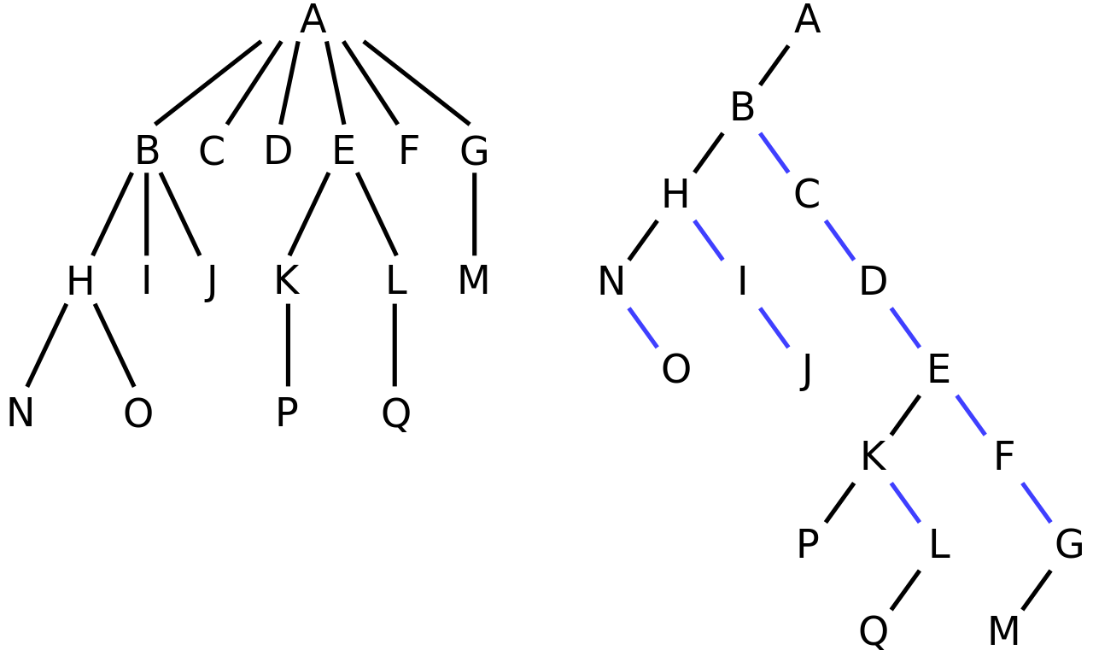
Convert the following General Tree to Binary tree

Slide 40
Expression Tree
The above figure is an example for an Expression Tree.
Definition:
It’s a Binary tree in which the non-terminals are operators and the Leaves or Terminals are operands.

Slide 41
Construction of an Expression Tree
Input : Post fix Notation
Output : Expression Tree
Procedure:
Read the post fix notation character by character from left to right.
When an operand is encountered push it on to stack.
When an operator is encountered pop the top most two character from the stack. A new tree is formed with operator as root and operand1 as RST and operand2 as LST. The newly formed tree is once again pushed on to the stack.
Repeatedly perform the operation until all the characters are read. The final resultant tree which is popped out from the stack would be an expression Tree.

Slide 42
Construction of an Expression Tree
Input:
a b + c d e + * *
Read the character a and b – Both are operands so push it on to the stack. Initially the stack is empty.
Initial Status of Stack After Reading a & b
( empty )
b
a

Slide 43
Construction of an Expression Tree
2. The Third Character is an operator so we pop out the two characters from the stack. Assign the 1st popped item as T1 and Second popped out character as T2.
3. Assign T1 as RST and T2 as LST with the operator as Root node.
4. The resultant tree is once again pushed on to stack
+
a
b

Slide 44
Construction of an Expression Tree
4. The resultant tree is once again pushed on to stack
e
d
c
Stack after pushing the tree Stack after reading c, d & e
5. The next character is an operator so repeat step2, 3 and 4.
6. Repeatedly read and do the corresponding operation until the last character is read.
+
+
a
b
a
b

Slide 45
Construction of an Expression Tree
The Final Resultant Expression Tree for the input postfix notation would be.
*
+
*
a
b
c
+
d
e

Slide 46
int maxDepth(struct node* node)
{
if (node==NULL)
{ return(0); }
else
{
int leftDepth = maxDepth(node->left);
int rightDepth = maxDepth(node->right);
if (leftDepth > rightDepth) return(leftDepth+1); else return(rightDepth+1);
}
}

Slide 47
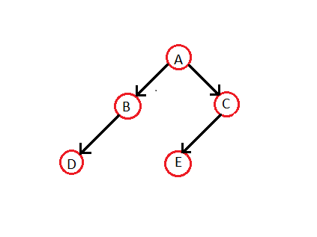
1.Represent the given Binary tree using array and linked list.
2. Construct an expression tree for the given postfix notation
a b + c d e + * *
3. For the following input data insert the elements to construct a Binary Search Tree and perform inorder traversal. { 4,3,2,1,6,7,8,5,9,10,11,12,13}
4. For problem3 construct an AVL tree (Do necessary rotations where ever required)

